Slide 1

Notes:
Hello everybody, and welcome! This is Stephan Kadauke speaking, from Philadelphia, and as the Chair of the Organizing Committee, I have the enormous pleasure to welcome you to the R/Medicine 2020 Virtual Conference!

Slide 2
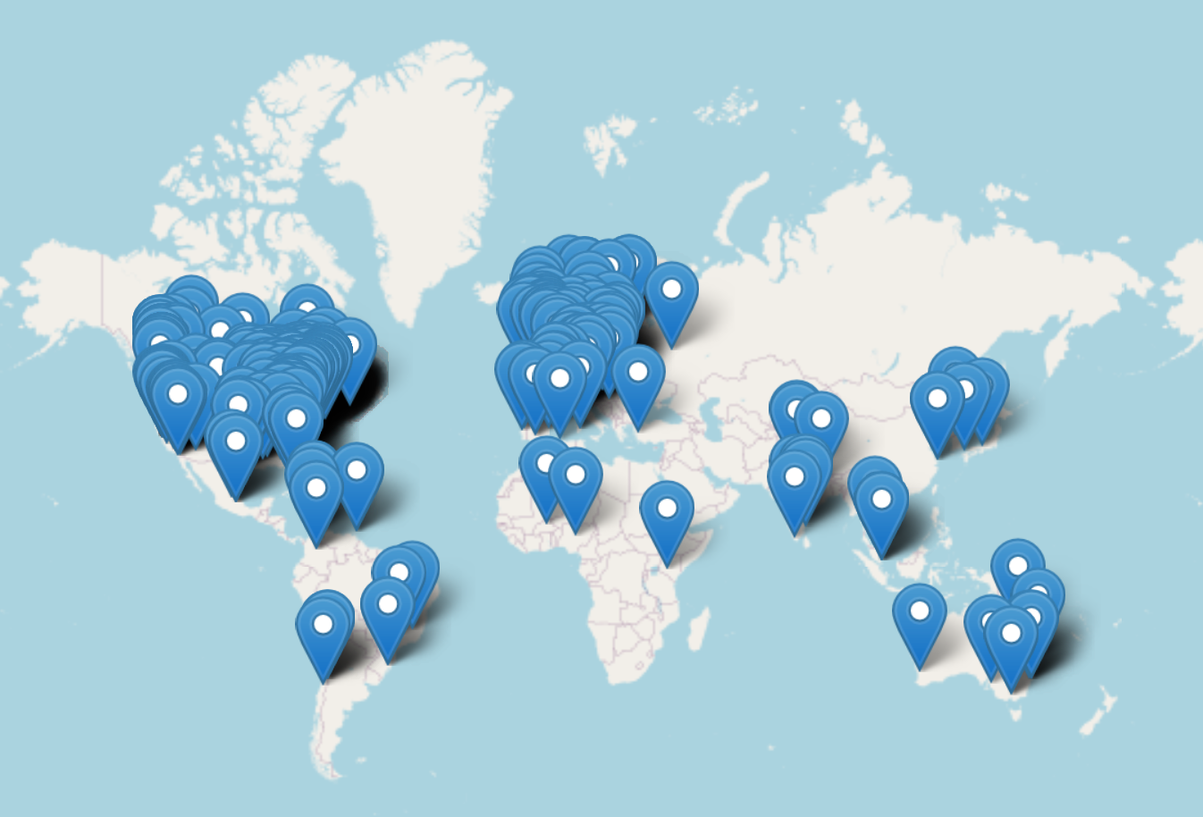
Key Stats
578 registrants, 77% show rate
32% non-US (43 countries)
16% physicians
4.75X growth from previous year
$17,000 revenue from registration
Less than $2000 in expenses
Platforms
Zoom for pre-conference workshops
Crowdcast for main conference
Slack for back-channel
Google Docs for planning and coordination
Partnerships
R Educators
RStudio EDU / Alison Hill
Underrepresented minorities
Minorities in R
R/Ladies Global
Medical Professional Societies
AACC (https://www.aacc.org)
MSACL (https://www.msacl.org)
Notes:
We will start tomorrow with the fourth theme, R in Clinical Practice, with a Keynote by Ewen Harrison, followed by a panel discussion, and contributed presentation by Steve Master, Cass Wilkinson Saldana, Joy Payton and Paulette McRae, Ted Ladera, and Dan Holmes.

